Slide 1

RedXParking
SPRINT 2
Notes:
Photo by Sean Pollock on Unsplash

Slide 2
SPRINT 2
Notes:
Photo by Sean Pollock on Unsplash

Slide 3
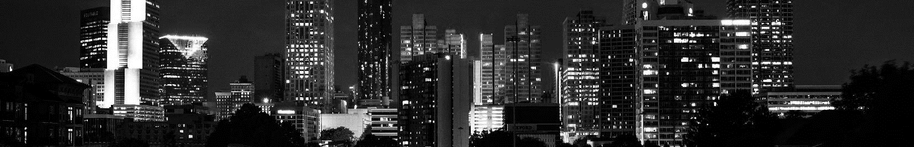
SPRINT 2 - GOALS
Adding pi camera for more accurate detection.
Integrating Melbourne Open parking data and the sensor data for better user experience.
Implementing of a php web application.
Notes:
<a href="https://www.freepik.com/free-photos-vectors/business">Business photo created by rawpixel.com - www.freepik.com</a>

Slide 4
Sense, Think & Act
Notes:
Photo by Sean Pollock on Unsplash

Slide 5
Sense, Think & Act
Sense – Detecting whether there is a vehicle in a parking spot
Data driven solution to address the issue using the publicly available dataset.
For the parking spots that doesn’t have sensors we implement our own sensors.
Think – Whether displaying available or occupied for the bay.
Act – displaying the status of the parking bay
Notes:
<a href="https://www.freepik.com/free-photos-vectors/business">Business photo created by rawpixel.com - www.freepik.com</a>

Slide 6
Backlog
https://app.gitkraken.com/glo/board/XW4APgtDJAAPHCC6
Notes:
<a href="https://www.freepik.com/free-photos-vectors/business">Business photo created by rawpixel.com - www.freepik.com</a>

Slide 7
GIT HUB LINK
https://github.com/SheronSuditha/RedXParking
Notes:
<a href="https://www.freepik.com/free-photos-vectors/business">Business photo created by rawpixel.com - www.freepik.com</a>

Slide 8
PHOTOGRAPHS AND DIAGRAMS OF HARDWARE SETUP.
Serial Cable
Jumper cables
Raspberry PI
Ultra Sonic Sensor
HDMI
Data logger Shield
Arduino Uno
PI Camera
Notes:
<a href="https://www.freepik.com/free-photos-vectors/business">Business photo created by rawpixel.com - www.freepik.com</a>

Slide 9
Data
The following diagram is a visualization of the location of the parking bays where some are present as well as some are unoccupied
Sensors in these location will be used to collect data about the parking bay.
Pi camera and PIR motion Sensors will be installed for other locations.
The graph represents the parking locations where the sensors are installed to monitor the status. Noted by Melbourne Open Data
Notes:
<a href="https://www.freepik.com/free-photos-vectors/business">Business photo created by rawpixel.com - www.freepik.com</a>

Slide 10
Data
The following diagram is a visualization of the location of the parking bays where some are present as well as some are unoccupied
Sensors in these location will be used to collect data about the parking bay.
Pi camera and PIR motion Sensors will be installed for other locations.
The graph represents the parking locations where the sensors are installed to monitor the status. Noted by Melbourne Open Data
Notes:
<a href="https://www.freepik.com/free-photos-vectors/business">Business photo created by rawpixel.com - www.freepik.com</a>

Slide 11
Data
The following diagram is a visualization of the location of the parking bays where some are present as well as some are unoccupied
Sensors in these location will be used to collect data about the parking bay.
Pi camera and PIR motion Sensors will be installed for other locations.
The graph represents the parking locations where the sensors are installed to monitor the status. Noted by Melbourne Open Data
Notes:
<a href="https://www.freepik.com/free-photos-vectors/business">Business photo created by rawpixel.com - www.freepik.com</a>

Slide 12

THE END
Notes:
<a href="https://www.freepik.com/free-photos-vectors/business">Business photo created by rawpixel.com - www.freepik.com</a>

